Slide 1
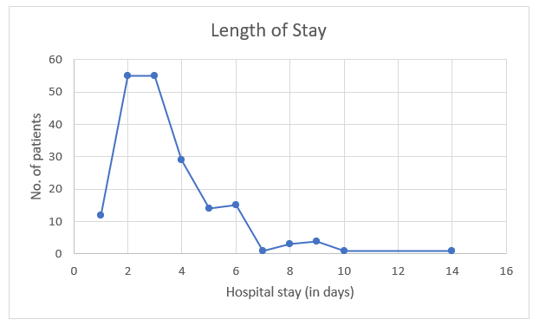
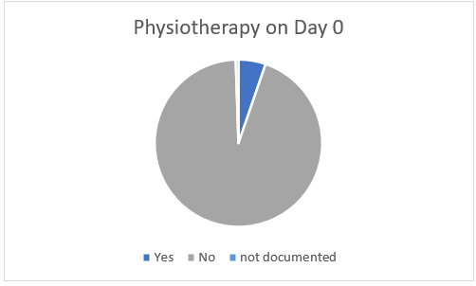
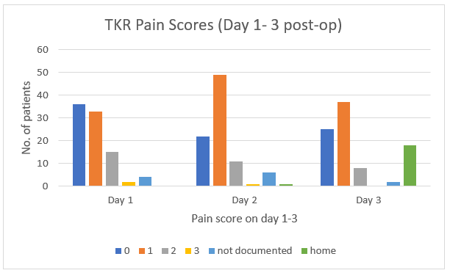
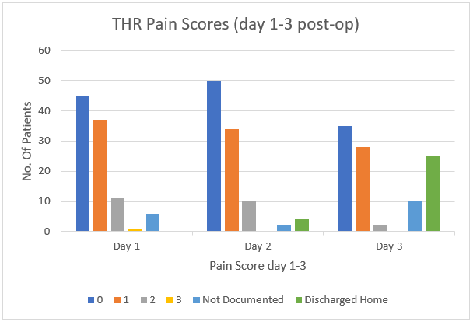
The Use of Enhanced Arthroplasty Patient Pathway to Support Recovery Following Elective Lower Limb Arthroplasty
C Persad, L Leong, E Smith
Alexandra Hospital, Worcestershire Acute Hospital NHS Trust
Figure 1: Summary of Enhanced Arthroplasty Patient Pathway, Worcestershire Acute Hospitals, Feb 2021
Enhanced recovery protocols consist of evidence based interventions that contribute to patient recovery & satisfaction, reduced post-operative complications and reduced length of hospital stay.1 This is of particular importance given the current pressures faced by the NHS.2 The development of the Enhanced Arthoplasty Patient Pathway (EAPP) at Worcestershire Acute Hospitals Trust began in 2020 with multiple integrated meetings which resulted in the release of an integrated patient pathway in February 2021.
The EAPP consists of evidence based guidelines for the intra-operative, post-operative and discharge period of patients undergoing elective primary total hip or total knee arthroplasty. This audit set out to assess compliance with the EAPP at Alexandra Hospital, patient outcomes in terms of pain scores and length of stay (LOS), in addition to reviewing reasons for deviating from the EAPP. As per the pathway, all patients should be included in the EAPP, unless within the exclusion criteria.
Summary of Enhanced Arthroplasty Patient Pathway, Worcestershire Acute Hospitals, Feb 2021
Introduction
Out of 190 patients eligible, 158 were managed as per the EAPP. Of those that deviated from EAPP, 21 were due to the use of intrathecal opiate. Accessing physiotherapy post-operatively appeared to be a significant issue, with only 10 out of 190 patients having physiotherapy on the day of surgery, despite the aim for patients to begin mobilisation 4 hours after spinal anaesthesia. Average Length of stay was 3.44 days with the most common documented reason for stay >72hours being ‘slow to mobilise with physiotherapy’, followed by hypotension. Only 1 patient had a pain score of 3 on day 1, with the majority having a score of 0. Pain was documented as a factor for increased length of stay in only 6 out of 190 patients.
Results
Intra-operative IV 1g Paracetamol IV 40mg Parecoxib IV 1g Tranexamic acid IV 1g Flucloxacillin and 120mg Gentamicin ( 800mg Teicoplanin for penicillin allergic) IV 4 mg Ondansetron IV 6.6mg Dexamethasone Spinal preferable with 2.0-3.0 ml of 0.5% heavy Marcain or 0.5% plain Bupivacaine, avoid opiates TCI sedation with Propofol Avoid urinary catheter If GA required Propofol, Fentanyl for induction Anaesthesia maintained with Sevoflurane, oxygen and air (avoid nitrous oxide) Further doses of Fentanyl for analgesia | Post-operative (GFR<60) PO Paracetamol 1g QDS for 10 days PO Oxycodone modified release 5-10mg BD for 3 days. N.B First dose in recovery PO Oxycodone liquid 5mg PRN 4 hourly ( maximum 4 doses in 24 hours) whilst in hospital, not for TTO PO Laxido 1 sachet BD for 10 days or PO Docusate 100mg bd for 10 days PO Ondansetron 4mg TDS for 3 days PO Codeine phosphate 60mg QDS for 7 days after completed 3 days of Longtec | Post-op Analgesia (GFR>60) PO Paracetamol 1g QDS for 10 days PO Ibuprofen 400mg TDS for 3 days ( unless contraindicated) PO Zomorph ( modified release morphine) 10-20mg BD for 3 days N.B First dose in recovery PO Oramorph 10-20mg mg PRN 4 hourly ( maximum 4 doses in 24 hours) whilst in hospital, not for TTO PO Laxido 1 sachet BD for 10 days or PO Docusate 100mg BD for 10 days PO Ondansetron 4mg TDS for 3 days PO Codeine phosphate 60mg QDS for 7 days after completing 3 days of Zomorph
Post-Operative (all patients) Anaesthetist to prescribe 2x 250ml bolus of crystalloid for use post-op. Nursing staff on the ward to give 1x 250ml crystalloid 30mins prior to mobilization. Further dose only if required. To mobilise 4 hours after spinal anaesthetic. All morning operated patients to be mobilised in the afternoon. Afternoon patients to be mobilised the following morning.
Data has been collected on all patients undergoing elective primary total hip or total knee arthroplasty during a 6 month period from July 2022- December 2022. Exclusion criteria included chronic pain patients (due to the need for individualised peri-operative analgesia regimens), severe cardiac or respiratory disease, stage 4 CKD or end stage renal failure, revision arthroplasty and patients with allergies to any of the drugs on the enhanced pathway. This left a remaining data set of 100 total hip replacements and 90 total knee replacements.
Patient ages ranged from 40 to 91, with a median of 72 and mean of 71. Patient ASA scores ranged from ASA 1 to ASA 4 with the majority being ASA 2 (64%) and ASA 3 (25%). Of those recorded, BMI ranged from 16.76 to 44.00, with an average of 29.29. Parameters assessed included compliance with EAPP, length of hospital stay, day 0 physiotherapy and day 1-3 pain scores. Where protocol was not followed, or discharge was beyond 72 hours, attempts were made to establish the reason, from documentation available.
Figure 4: Graph demonstrating Length of hospital stay in days
Figure 5: Pie chart demonstrating number of patients who received physiotherapy on Day 0
Methods
The results from this audit demonstrated there is scope within the trust for improving compliance with EAPP, particularly with regard to reducing the use of intrathecal opiates. The reason for this deviation is unclear but is possibly due to individual anaesthetic preferences, or lack of awareness of EAPP with the rotation of trainee anaesthetists. Pain was not considered a significant contributing factor in the majority of cases of increased LOS. It is clear that work is needed to improve physiotherapy availability post-operatively, in order to improve early patient mobilisation, which was a common theme in those with LOS >72 hours. The mean LOS was less than the previous EAPP audit, but this may reflect the comparatively lower number of ASA 3 & ASA 4 patients, compared to the previous data set.
Conclusion
Figure 2. Bar Chart demonstrating post-operative pain scores for total knee replacements on day 1-3. Pain score of 0= none, 1=mild, 2=moderate, 3=severe.
Figure 3: Bar Chart demonstrating post-operative pain scores for total hip replacements on day 1-3. Pain score of 0= none, 1=mild, 2=moderate, 3=severe.
References
1.NICE Guidelines – Perioperative care in adults. Available from https://www.nice.org.uk (accessed March 2023)
2. Royal College of Surgeons- Recovery of surgical services during and after COVID 19. Available from https://www.rcseng.ac.uk (accessed March 2023)

